Slide 1
In the pursuit of (prospective) project
[Problem Based Learning → Software Engineering]
[Content Guru]
Prof. Brijesh S. Bhatt (brij.ce@ddu.ac.in)
Prof. Jigar M. Pandya (jigarpandya.ce@ddu.ac.in)
Department of Computer Engineering
Faculty of Technology
DHARMSINH DESAI UNIVERSITY, NADIAD.
** This is a department activity. All staff members and students are involved in some or other initiative directly or indirectly.
**Topics covered are not the sole list of activities.

Slide 2
Background
To bolster both FACULTIES’ and STUDENTS’ voyage “In the pursuit of (prospective) project”, Department of Computer Engineering, FoT. DDU. has following insight:
Let us make both stack holders ready for (prospective) project,
From the Sources of Projects:
Industry collaboration
Teachers’ research work
Institute’s software requirement

Slide 3
Problem solving based learning (PBL)
With the approach of “Problem solving based learning-PBL”
Step 1 : Identify projects for which required technical competency aligns with curriculum.
Step 2 : Decide duration of project & various subject heads under which it can be offered.
Step 3 : Create the team
Step 4 : Task planning as per the students’ academic needs.
Step 5 : Distribute tasks and decide milestones
Step 6 : Monitor the progress and provide necessary support.

Slide 4
Justification
Innovative Practices/Approach/Steps:
1. Identify Projects 2. Duration and Subjects 3. Create Team
Evidences: Steps 1-2-3
Gimbal Research Project : Industry collaboration
Technically challenging task of one year. Requires knowledge of hardware, micro controllers
Good learning opportunity for students learning or interested in micro controller
Semantic Information Retrieval : Faculty research
Suitable for final year full time project. Requires knowledge of search engines, information retrieval theory, JAVA programming
Given the tasks. Learn and apply. Group as per skillset and interest.
Employee leave management System : Department software application
Mid-term efforts. Requires knowledge of Software Engineering and Web Application Development
2-3 students of pre-final year with required skills.

Slide 5
Step 4, 5 : Task Planning & milestone
To grow technical competency, CE Department has integrated Projects at various Courses Level as below:
From first year, graduate students to work on/extend mini project(s) under departmental subjects
Pre final year graduate students carry out tasks
Amalgamated project pre-work (BTech V - DBS for database design and SE for System Design)
Under subject head ‘System Development Practices’ and ‘Summer Internship’
Final year graduate students perform tasks as full time project/internship in last semester
Post graduate students perform survey and research as part of ‘Thesis/Dissertation’

Slide 6
Step 6 : Progress monitoring & support
Role of the teacher:
Teacher does not perform traditional role of teaching the technical content. Teacher rather acts as a mentor which provides necessary knowledge and guidance.
Let students make hand dirty and learn lessons hard way.
Once students face challenges provides necessary technical support to overcome it.
Let student brain storm and find solution.
Provide knowledge incrementally, talk about task -2 (usually more difficult) once the task-1 is finished.

Slide 7
Faculties in Action
Faculties’ Exemplary Live Development (Ongoing and Past)
Industry collaboration
Gimbal Research Project
Snort Application Identification
Faculty research
Semantic Information Retrieval
Institute Software
E-Governance Student and University Portal
Includes customized moodle – Online Learning Resource
Department software
CE Faculty Portal
Subject Preference
Leave Management
Document Archive
Library Management (local)

Slide 8
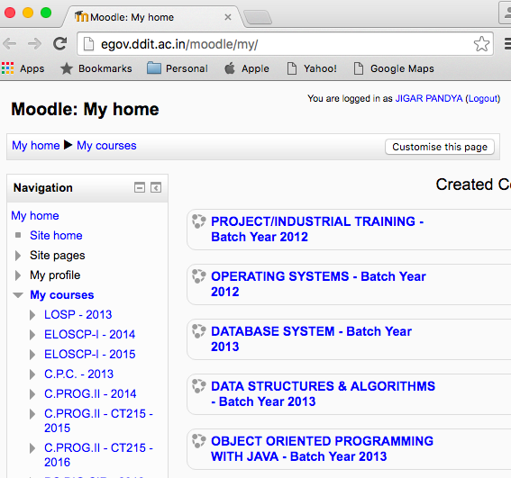
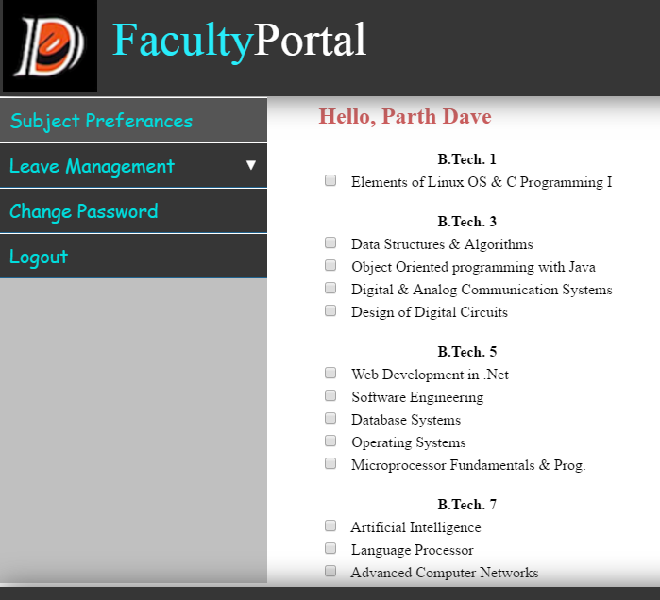
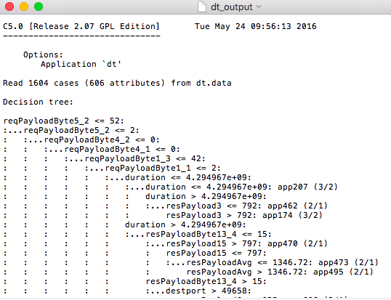
Few Captures
Institute Software
Industry Collaboration
Department Software

Slide 9
Students in Action
Students’ Exemplary Live Development (Ongoing and Past)
Web and mobile based information sharing for Felicific, the annual Techno-cultural festival
Mobile App for viewing results and more
Web based University Newsletter (University level)
Web based Faculty feedback by students, an ISO mandate
National level eYantra robot design and software development project competition winner for three consecutive years 2012, 2013, 2014 at IIT Bombay

Slide 10
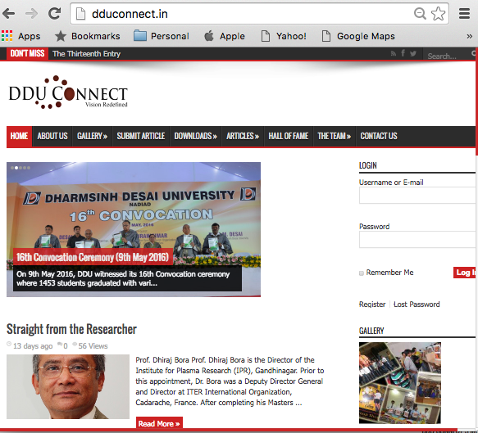
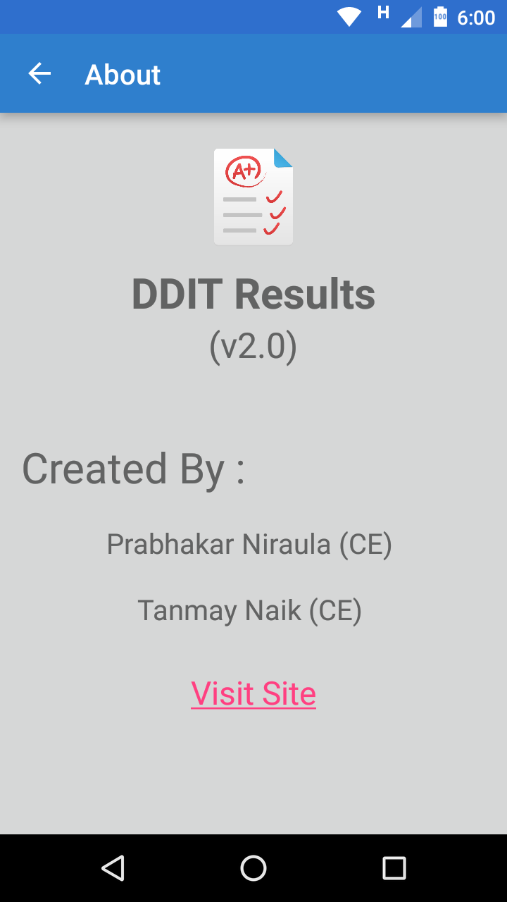
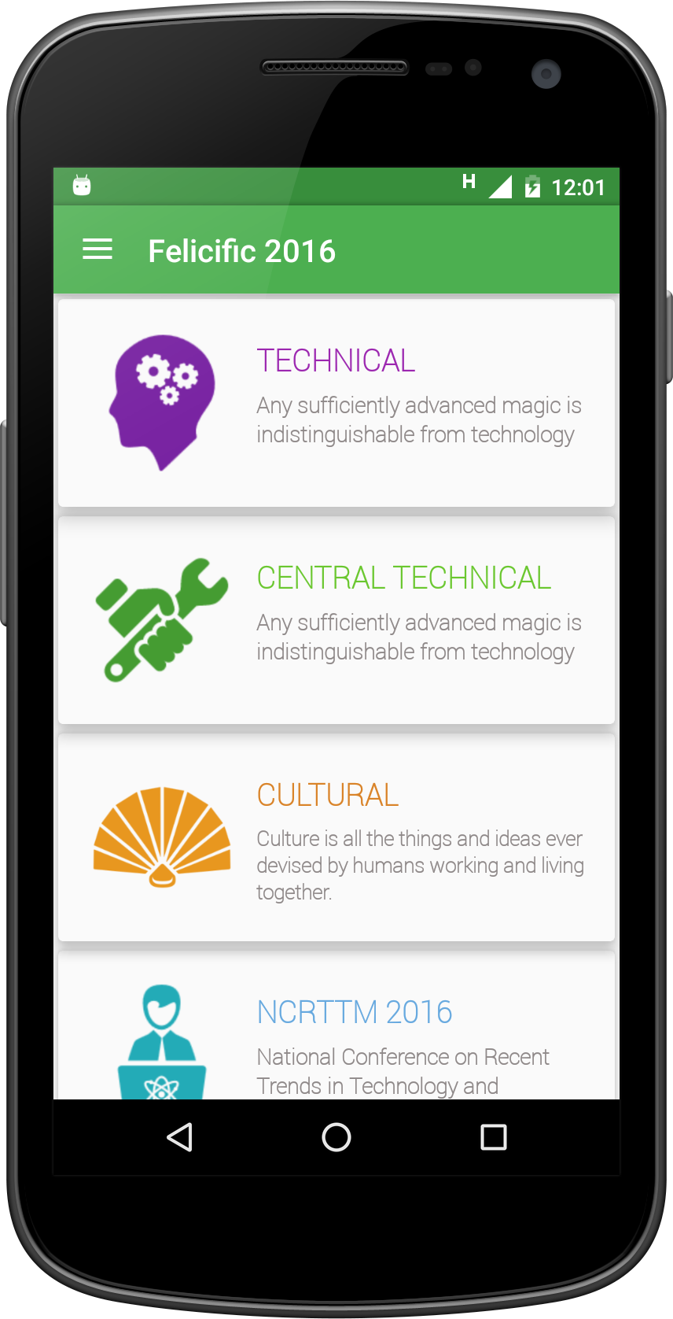
Few Captures
News Letter
Techno-cultural festival
Results on the Go

Slide 11
Software Engineering Contents
The CONTENT in itself bolsters the initiatives year by year
Documentation
Project Report with Analysis, Design, Implementation, Testing and more.
Demonstration (BTech_VI_SystemDePractices)
Telling a story of application usage with finger tips
Presentation (BTech_VIII_IndustrialTraining)
Technologies and crucial logic behind the scene
Distribution
Packaging and sharing i.e. github, playstore, etc.

Slide 12
Software Engineering Contents

Slide 13
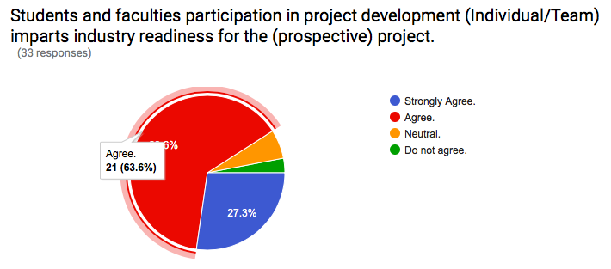
Feedback

Slide 14
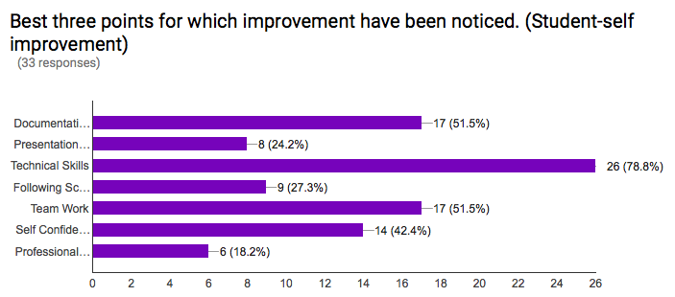
Feedback
These initiatives, prepare students and faculties for (prospective) projects especially better with documentation, technical and team work skills.

Slide 15
Appreciation**
Faculty is very supportive. All the things which I learnt during this entire period, I was able to apply that practically via SDP.[Current Student]
The practical knowledge imparted to students is far better than other colleges [Former student/Industrialist]
Teaching is already nice, can be improved by visualizing boring theories this way. [Former student/Industrialist]

Slide 16
Conclusion
With the attentive PBL steps as mentioned, we see the positive difference in
Students’ and Faculties’ project/industry readiness
Effectiveness attained with
Documentation Skills
Presentation Skills
Technical Skills
Following schedule/Time management
Team work, Self confidence, Professional Circle Development skills
Overall, Software Engineering turned interesting and challenging
Students learnt importance of each stage the hard way
Students’ resume and interview appearance have better impact of product they built
Thus, at Computer Engineering Department, FoT, D.D.University, Nadiad, we just do not teach Software Engineering but we actually work to impart Software Engineering.

Slide 17
References www.ddu.ac.in
https://en.wikipedia.org/wiki/Problem-based_learning
http://egov.ddit.ac.in
http://egov.ddit.ac.in/moodle
http://dduconnect.in/
https://www.facebook.com/felicific2k16/
https://github.com
https://play.google.com/store/apps
https://www.microsoft.com/en-us/store/apps
https://docs.google.com/forms/d/1vdpMzfyzdktrrmh-3ImxkfLhpPhmOjWeY5I6zPAu-Fg/viewform?c=0&w=1

